Slide 1

Data Structures
(CS1203)
Dept. of CSE,
RGUKT IIIT Srikakulam
Note: This is for reference only, for more refer class notes.

Slide 2
Trees ( Part-1)

Slide 3
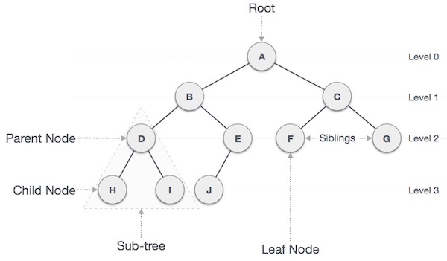
Tree:
A Tree Is recursively defined as a set of one or more nodes where one node is designated as root node and all the remaining nodes can be partitioned into non empty sets each of which is a sub tree of the root.

Slide 4

Nature View of a Tree
leaves
branches
root

Slide 5

Computer Scientist’s View
root
leaves
branches
nodes

Slide 6
Basic terminology:
Root
The top node in a tree.
Child
A node directly connected to another node when moving away from the root.
Parent
The converse notion of a child.
Siblings
A group of nodes with the same parent.
Descendant
A node reachable by repeated proceeding from parent to child. Also known as subchild.
Ancestor
A node reachable by repeated proceeding from child to parent.
Height of a node:
The height of a node is the number of edges on the longest path between that node and a descendant leaf.
Height of tree
The height of a tree is the height of its root node.

Slide 7
Basic terminology (continue):
Leaf { External node (not common)}
A node with no children.
Branch node / Internal node
A node with at least one child.
Degree
For a given node, its number of children. A leaf is necessarily degree zero.
Edge
The connection between one node and another.
Path
A sequence of nodes and edges connecting a node with a descendant.
Level
The level of a node is defined as: 1 + the number of edges between the node and the root.
Depth
The depth of a node is defined as: the number of edges between the node and the root.
Forest
A forest is a set of n ≥ 0 disjoint trees

Slide 8
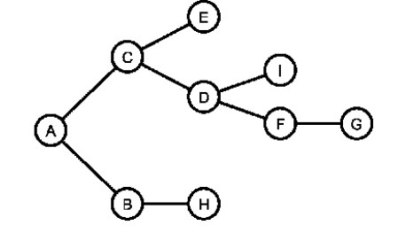
Types of Trees
General Tree
A general tree stores elements hierarchically, the top node of a tree has root node and each node except the root node has a parent.
1) A node in general tree (except leaf node) may have zero or more sub trees.
2) In General trees, if a node have at most two sub trees called as Binary trees.
3) In General trees, if a node have at most three sub trees called as Ternary trees. Etc.,
Forests
A forest is a disjoint union of trees. A set of disjoint trees is obtained by deleting the root and the edges connecting the root node to nodes at level 1.
→ By deleting A, The tree converted to Forests.

Slide 9
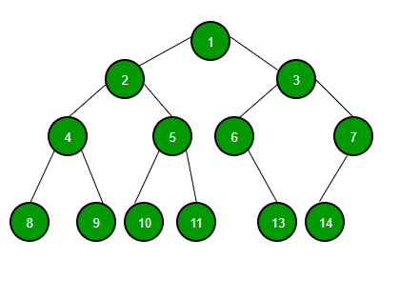
Binary Tree
A tree whose nodes have at most 2 children is called a binary tree. Since each node in a binary tree can have only 2 children, we typically name them the left and right child.
If a tree having height “h” can have
maximum of (2^h+1)-1 nodes
Minimum of h+1 nodes

Slide 10
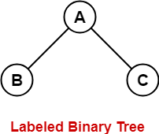
Labelled Binary Trees
A labeled tree is a tree the vertices of which are assigned unique numbers from 1 to n
Let a tree having n labelled nodes we can construct [(2n Cn)/n+1]*n! binary trees

Slide 11
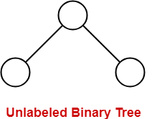
Unlabelled Binary Trees
A Binary Tree is unlabelled if nodes are not assigned any label
Let a tree having n unlabelled nodes we can construct [(2n Cn)/n+1] binary trees

Slide 12
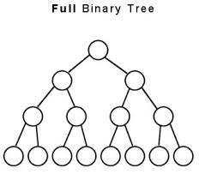
Full Binary Tree
A Binary tree is said to be Full Binary Tree, if all its internal nodes has 0 or 2 children. In other words, if all the nodes other than leaf nodes has 0 or 2 children, then that it is Full Binary Tree.
It is also called as Strictly Binary Tree/Extended Binary Tree

Slide 13
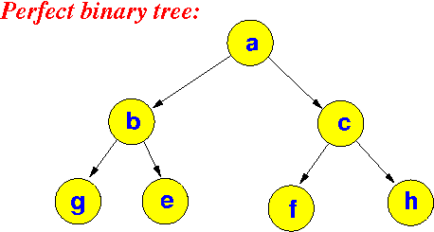
Perfect Binary Tree
A Binary tree is said to be Perfect Binary Tree, if all its internal nodes has exactly 2 children. In Perfect Binary Tree, all leaf nodes are on the same level or depth.
Nth level must be have 2^i elements , where I is level of the tree

Slide 14
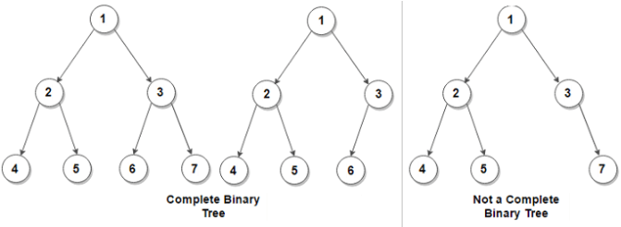
Complete Binary Tree
A Binary tree is said to be complete Binary Tree if all levels are completely filled except possibly the last level and the last level has all keys as left as possible.
All the n-1 levels should be completely filled
Nth level elements must be arranged as left as possible

Slide 15
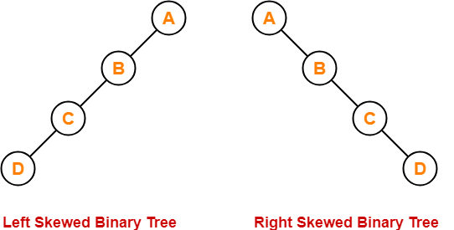
Skewed Binary Tree
Left Skewed
If tree completely going to left called as left skewed binary tree
Right Skewed
If tree completely going to right called as right skewed binary tree

Slide 16
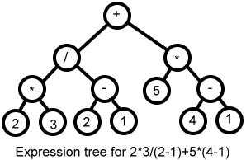
Expression Binary Tree
The tree which is used to store the Expressions

Slide 17
Trees Implementation
We can implement binary trees in 2 ways
1.Arrays
2.Linked Lists
Traversing in a Binary tree can be done in three ways:
1. In order
2. Pre order
3. Post order

Slide 18
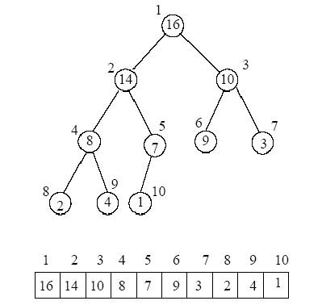
Array Representation
If Array index starts with 0 then,
Right Child Of ith node = 2i+2
Left Child Of ith node = 2i+1
If Array index starts with 1 then,
Right Child Of ith node = 2i+1
Left Child Of ith node = 2i

Slide 19
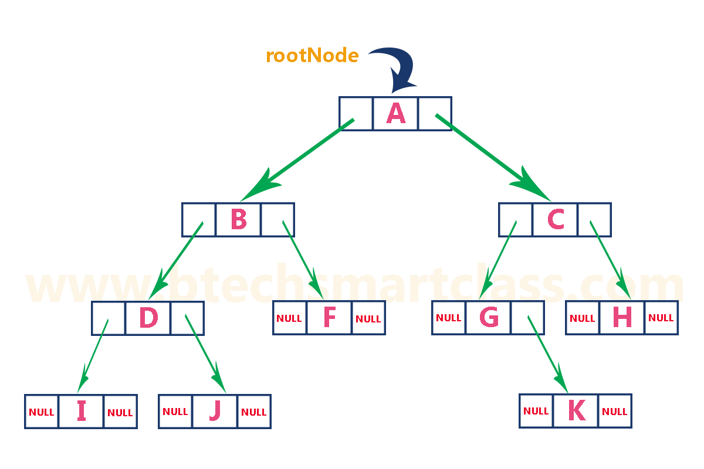
Linked List Representation
In linked representation, every node contains 3 fields:
Left Pointer
Data
Right Pointer

Slide 20
Traversing Techniques
Unlike linear data structures (Array, Linked List, Queues, Stacks, etc) which have only one logical way to traverse them, trees can be traversed in different ways.
Following are the generally used ways for traversing trees.
Pre order(H,L,R)
In order(L,H,R)
Post order(L,R,H)
L → Left R → Right H→ Head

Slide 21
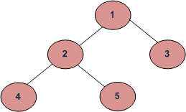
Pre Order
First we go for Head Node then Left and Then we go for Right Node
This Process Will Perform Recursively Until We get required data
It is also called as “NLR technique”
Where N → Node L → Left R → Right
Used to extract prefix notation from an expression tree.
The pre order for the following tree is 1 2 4 5 3

Slide 22
In Order
First we go for Left Node then Head and Then we go for Right Node
This Process Will Perform Recursively Until We get required data
It is also called as “LNR technique”
Where N → Node L → Left R → Right
Used to display the elements in sorted order from BST.
Solution for the following tree is 4 2 5 1 3

Slide 23
Post Order
First we go for Left Node then Right and Then we go for Head Node
This Process Will Perform Recursively Until We get required data
It is also called as “LRN technique”
Where N → Node L → Left R → Right
These are used to extract Postfix expression
Solution for the following tree is 4 5 2 3 1

Slide 24
Questions:
Construction a binary tree for the In-order traversal: D B E A F C G
Pre order traversal: A B D E C F G
Follow the class notes for procedure.

Slide 25
Applications
A binary tree can be useful to implement Huffman Tree, BST, Binary tries, hash trees, Heaps etc.,
Traversals of trees result in infix , postfix and prefix forms expressions
Storing naturally hierarchical data ex: file system (BST)
Organize data for quick search , insertion and deletion ( BST)
Trie – Dictionary
Network routing algorithms etc.,

Slide 26
Huffman Coding

Slide 27
Huffman Coding
Huffman coding is proposed by David A. Huffman in 1952
It is the one of the application of Binary Search Trees.
It is Used for compression of Files.
Compression is Nothing but reducing the size.
We use this Huffman coding in WinRar,WinZip,7zip Applications etc..,

Slide 28
Huffman Tree
It is used for to give unique encoding to a particular code or string
Properties Of Huffman Tree
It should contain root node
Internal nodes are indicated with circles( ) and it should contain weights.
External nodes are indicated with squares( )and they should contain Frequency & Characters.

Slide 29
Normal Encoding
Let we take an example
Let there are 7 characters in a string and each character is represented in 8 bits(ASCII CODES)
ASCII
a-97
b-98
c-100
d-101
BINARY(8 bits)
a-01100001
b-01100010
c-01100011
d-01100100
Binary Encoding Representation
a b c d a a b
01100001 01100010 01100011 01100100 01100001 01100001 01100001 01100010
For representing abcdaab we need 7*8=56 bits
To reduce the bits we go for frequent characters.

Slide 30
Frequent Characters Technique
In frequent characters technique the frequent occur character will take less bits and rarely occur character will take large bits.
Let’s take the previous example , in this method we first calculate frequency of characters.
Highest frequency character is represented with less bits and lowest frequency character is represented with large bits.
Representation
a-0
b-10
c-110
d-111
a b c d a a b
0 10 110 111 0 0 10
By this technique for representing abcdaab we need only 13 bits.

Slide 31
Construction Of Huffman Tree
1.Scan text to be compressed and count occurrence of all characters.
2.Sort characters based on number of occurrences in text.
3.Take 2 characters which are having least frequency as leaf nodes.
4.And sum the data of that nodes and take it as it’s parent node.
5.Take next least occurred node and compare with parent node.
6.If compared node > parent node place at right side of parent node.
7.Else place at left side of parent node and repeat the procedure from step 4.
8.Perform a traversal of tree to determine all code words.

Slide 32
Huffman Tree Logic
HT( )
{
N=Priority Queue ;
Sort(N);
for(i=1 to n-1)
{
create_Node; //Z
Z.left = min(Z);
Z.right = Next_min(N);
Z.frequency=Z.left + Z.right;
push(z.frequency)
}
}

Slide 33
Key words of Huffman Tree
Internal path length
The longest path from root node to corresponding internal node.
External path length
The longest path from root node to corresponding external node.
Let n be the number of internal nodes then,
External path length = Internal path length+2*n
External weighted nodes = External path length * Frequency of External Node
Sum of External weighted nodes = storage

Slide 34
Examples
String = ab ab cba ; Occurrences = a→3;b→3;c→1;space→2;eof→1;
c,eof=1;space=2;a,b=3
2
2
2
2
1
1
→
→
Space
c eof
1
1
1
1
1
c eof
c eof

Slide 35
Continue….
Continue…..
3
4
4
4
a
2
2
→
2
2
→
2
2
Space
Space
Space
1
1
1
1
1
1
c eof
c eof
c eof

Slide 36
Continue…
Continue…..
7
3
7
b
3
4
3
4
a
a
3
4
→
a
→
2
2
2
2
2
2
Space
Space
Space
1
1
1
1
1
1
c eof
c eof
c eof

Slide 37

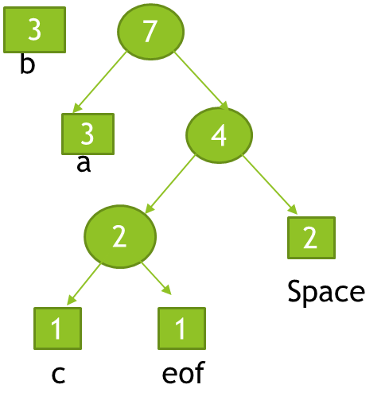
Continue..
Encode with 0’s at left side and 1’s at right side nodes of every parent node to get the representation of characters in bits.
10
Representation
b-0
a-10
c-1100
Space-111
eof-1101
→
0 1

Slide 38
Calculations For Example
For Previous Example Huffman tree
Internal Length = Sum of Internal Lengths of internal nodes
1(7)+2(4)+3(2)+0(10)=6
External length = Sum of External Lengths of External nodes
4(c)+4(eof)+3(space)+2(a)+1(b)=14
Storage = sum of weighted external nodes = sum of(external path length*frequency)
(4*1)+(4*1)+(3*2)+(2*3)+(1*3) = 23
10,7,4,2 Are Internal Nodes
c,eof,space,a,b Are External Nodes
1,1,2,3,3 Are Frequencies Of External Nodes

Slide 39
Binary Search Trees(BST)

Slide 40
BST:-
To Overcome The Time Complexity Of Searching in Binary Trees, We go for BST.
In A Binary tree in which for each node, value of all the nodes in left sub tree is lesser or equal and value of all the nodes in right sub tree is greater.
If we apply In order on BST we get sorted order.
Time Complexity Of Searching in BST is
1) Best → O(log n)
2) Worst → O(n)
8
5
11
2
6
10
12
4
7
9
14
13

Slide 41
Example and Counter-Example
8
5
5
11
4
8
2
7
6
10
18
1
7
11
4
15
20
3
NOT A
BINARY SEARCH TREE
BINARY SEARCH TREE
21

Slide 42
BST:-
We can perform different type of operations on BST like find, insertion , deletion etc.,
Iterative Find:
Node *
find(Comparable key, Node * t)
{
while (t != NULL && t->key != key)
{
if (key < t->key)
t = t->left;
else
t = t->right;
}
return t;
}
10
5
15
2
9
20
7
17

Slide 43
Insert
->we can do recursive find also
void
insert(Comparable x, Node * t)
{
if ( t == NULL ) {
t = new Node(x);
} else if (x < t->key) {
insert( x, t->left );
} else if (x > t->key) {
insert( x, t->right );
} else {
// duplicate
// handling is app-dependent
}
Concept:
Proceed down tree as in Find
If new key not found, then insert a new node at last spot traversed

Slide 44
Deletion - Leaf Case You can directly delete if it is leaf node
Delete(17)
10
5
15
2
9
20
7
17
30

Slide 45
Deletion - One Child Case
Delete(15)
10
Procedure:
Append the child of deleted node to parent node and then delete
5
15
2
9
20
7
30

Slide 46
Deletion - Two Child Case
10
Procedure:
Take left sub tree maximum or right sub tree minimum and replace with the deleted element
5
20
2
9
30
Delete(5)
7

Slide 47
Generally searching of a node in BST is O(log n) where n is the total number of nodes.
But in Worst case it will get O(n) time complexity to search for a node i.e., when the tree is completely left skewed or right skewed BST.
So, to overcome this drawback, we move for Balanced Binary Search Trees:
1) AVL Trees
2) Red Black Trees
3) Splay Trees
where you will get a time complexity for searching is O(log n)

Slide 48
AVL Trees
An AVL TREE is a Binary Search Tree with balance condition in which the sub-trees of each node can differ by at most 1 in their height.
The technique of balancing the height of binary trees was developed by Adelson, Velskii, and Landi and hence given the short form as AVL tree or Balanced Binary search Tree.

Slide 49
Why we are moving to AVL TREES?
The disadvantage of a binary search tree is that its height can be as large as N-1.
This means that the time needed to perform insertion, deletion and many other operations can be O(N) in the worst case.
So we need a tree with small height.
A binary search tree with N node has height at least O(N) at worst case.
Thus, our goal is to keep the height of a binary search tree in the worst case also O(log N).
Such trees are called balanced binary search trees. Examples are AVL tree, red-black tree, splay trees , B- Trees etc.,

Slide 50
AVL Tree:
1. Sub-trees of each node can differ by at most 1 in their height.
2. Every sub-trees should be an AVL tree.
3. In AVL Tree, Every node can have balance factor either -1, 0 or +1 and remaining balance factor for a node can be called as invalid AVL Tree.
4) The height of an AVL tree storing n keys is O(log N).
5) Balance factor of a node.
BF=height(left subtree) - height(right subtree).
6) calculate balance factor calculated at every node.
7) AVL Tree stores balance factor in each node.

Slide 51
INSERTION:
Insertion is similar to regular binary search tree, after inserting check the balance factor of each node.
If any node having balance factor other than -1, 0 or +1, we need to balance the tree.
To make balance the tree, we need to apply rotations there fore it guarantees O(log n) time complexity.
Different types of rotations are:
Single rotation:
1) LL 2) RR
Double rotation:
1) LR 2) RL

Slide 52
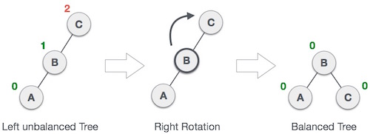
DOUBLE ROTATION
1.LL NOTATION.
When the node is inserted at the left side of left sub tree which has balanced factor +2,that condition is called LL notation.
Rotate the parent in clockwise direction.

Slide 53
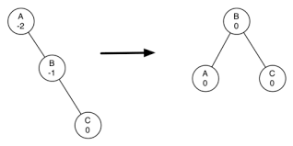
2.RR NOTATION
When the node is inserted at right side of right sub tree which has no right sub tree, that condition is called RR notation.
Rotate the parent in anti-clockwise direction.

Slide 54
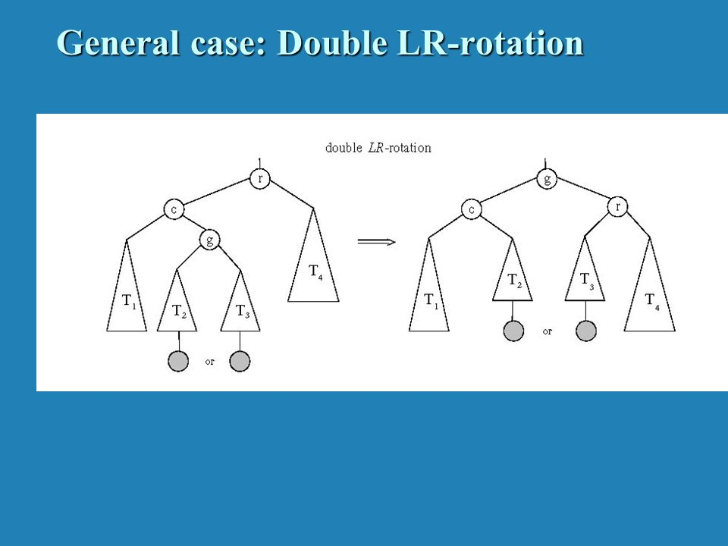
DOUBLE ROTATION
LR NOTATION
When the node is insterted at right side of left sub tree which has no right sub tree,that condition is called LR notation.
Rotate the parent in ANTI-CLOCKWISE and then CLOCKWISE direction in LR notation.

Slide 55
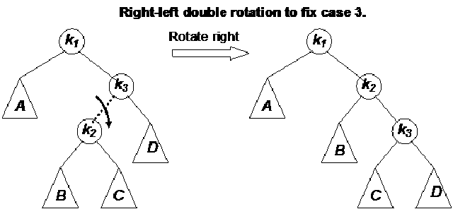
2.RL NOTATION
When the node is inserted at left side of right sub tree of a node which has no left sub tree, that condiiton is called RL notation.
Rotate the parent in CLOCKWISE and then ANTI-CLOCKWISE directionin LR notation.

Slide 56
AVL Tree Example:
Insert 14, 17, 11, 7, 53, 4, 13 into an empty AVL tree
14
11
17
7
53
4
After inserting node 4, AVL Tree is imbalanced i.e., for node 11, the balance factor is +2.
The Balance factor +2 means, tree is unbalanced, so we need to find what kind of notation applied to the tree.
Here we will apply LL notation based on the above slides

Slide 57
Insert 14, 17, 11, 7, 53, 4, 13 into an empty AVL tree
14
7
17
4
11
53
13

Slide 58
AVL Tree Example:
Now insert 12
14
7
17
4
11
53
13
12

Slide 59
AVL Tree Example:
Now insert 12
14
7
17
4
11
53
12
13

Slide 60
AVL Tree Example:
Now the AVL tree is balanced.
14
7
17
4
12
53
11
13

Slide 61
AVL Tree Example:
Now insert 8
14
7
17
4
12
53
11
13
8

Slide 62
AVL Tree Example:
Now insert 8
14
7
17
4
11
53
8
12
13

Slide 63
AVL Tree Example:
Now the AVL tree is balanced.
14
11
17
7
12
53
4
8
13

Slide 64
DELETION
While performing Deletion, we will follow same cases of Binary search tree.
Deletion of a node can be either a
1) zero children node
2) single children node
3)two children node.
After performing deletion, need to check balance factor of each node, if tree is Violating the AVL Tree properties then you need to rebalance the entire tree.

Slide 65
Balancing the AVL Tree after deleting a node:
To balance the AVL tree after deleting, we have to do some rotations.
They are
1.R0 ROTATION
2.R1 ROTATION
3.R-1 ROTATION
4. L0 ROTATION
5. L1 ROTATION
6. L-1 ROTATION

Slide 66
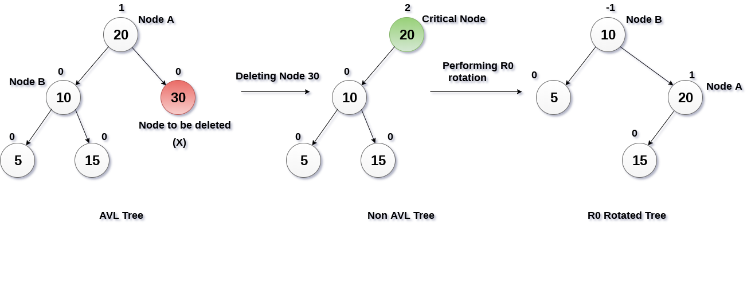
Deletion at right side:-
1.R0 ROTATION:-
If the deleted node is at the right side of a tree and the balance factor of the root node is +2 and the left first child balance factor is 0,we call it as R1 notation.
Rotate the left child or the parent in clockwise direction.

Slide 67
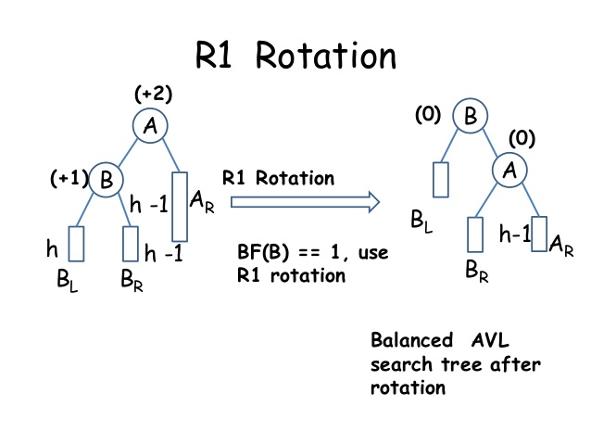
2.R1 ROTATION:-
If the deleted node is at the right side of a tree and the balance factor of the root node is +2 and the left first child balance factor is 1,we call it as R1 notation.
Rotate the left child of the parent in clockwise direction.

Slide 68
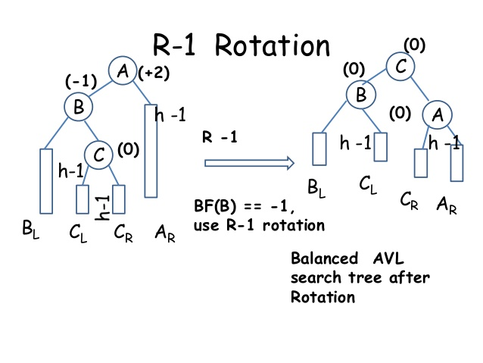
3.R-1 ROTATION
If the deleted node is at the right side of a tree and the balance factor of the root node is +2 and the left first child balance factor is -1,we call it as R1 notation.
Rotate the left child of the parent in anti-clockwise direction and then in clockwise direction.

Slide 69
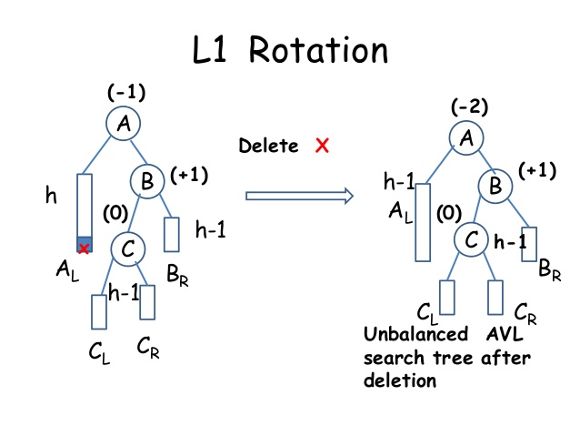
2.Deletion at left side
1.L1 ROTATION
If the deleted node is at the left side of a tree and the balance factor of the root node is -2 and the right first child balance factor is +1,we call it as R1 notation.
Rotate the right first child of the parent in clockwise and then anti-clockwise to balance here.

Slide 70
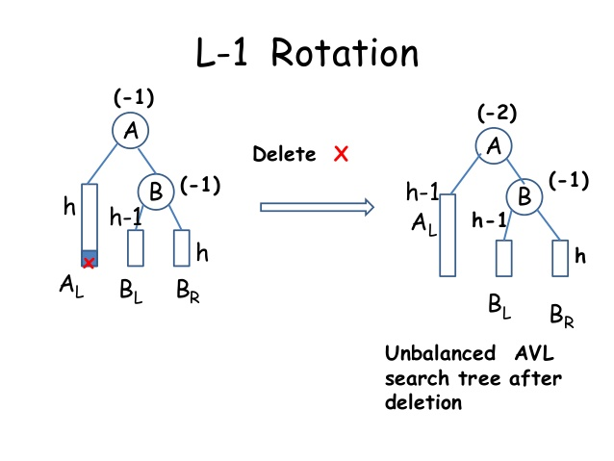
2.L-1 ROTATION:-
If the deleted node is at the left side of a tree and the balance factor of the root node is -2 and the right first child balance factor is -1,we call it as L-1 notation.
Rotate the right first child of parent in anti-clockwise direction to balance here.

Slide 71
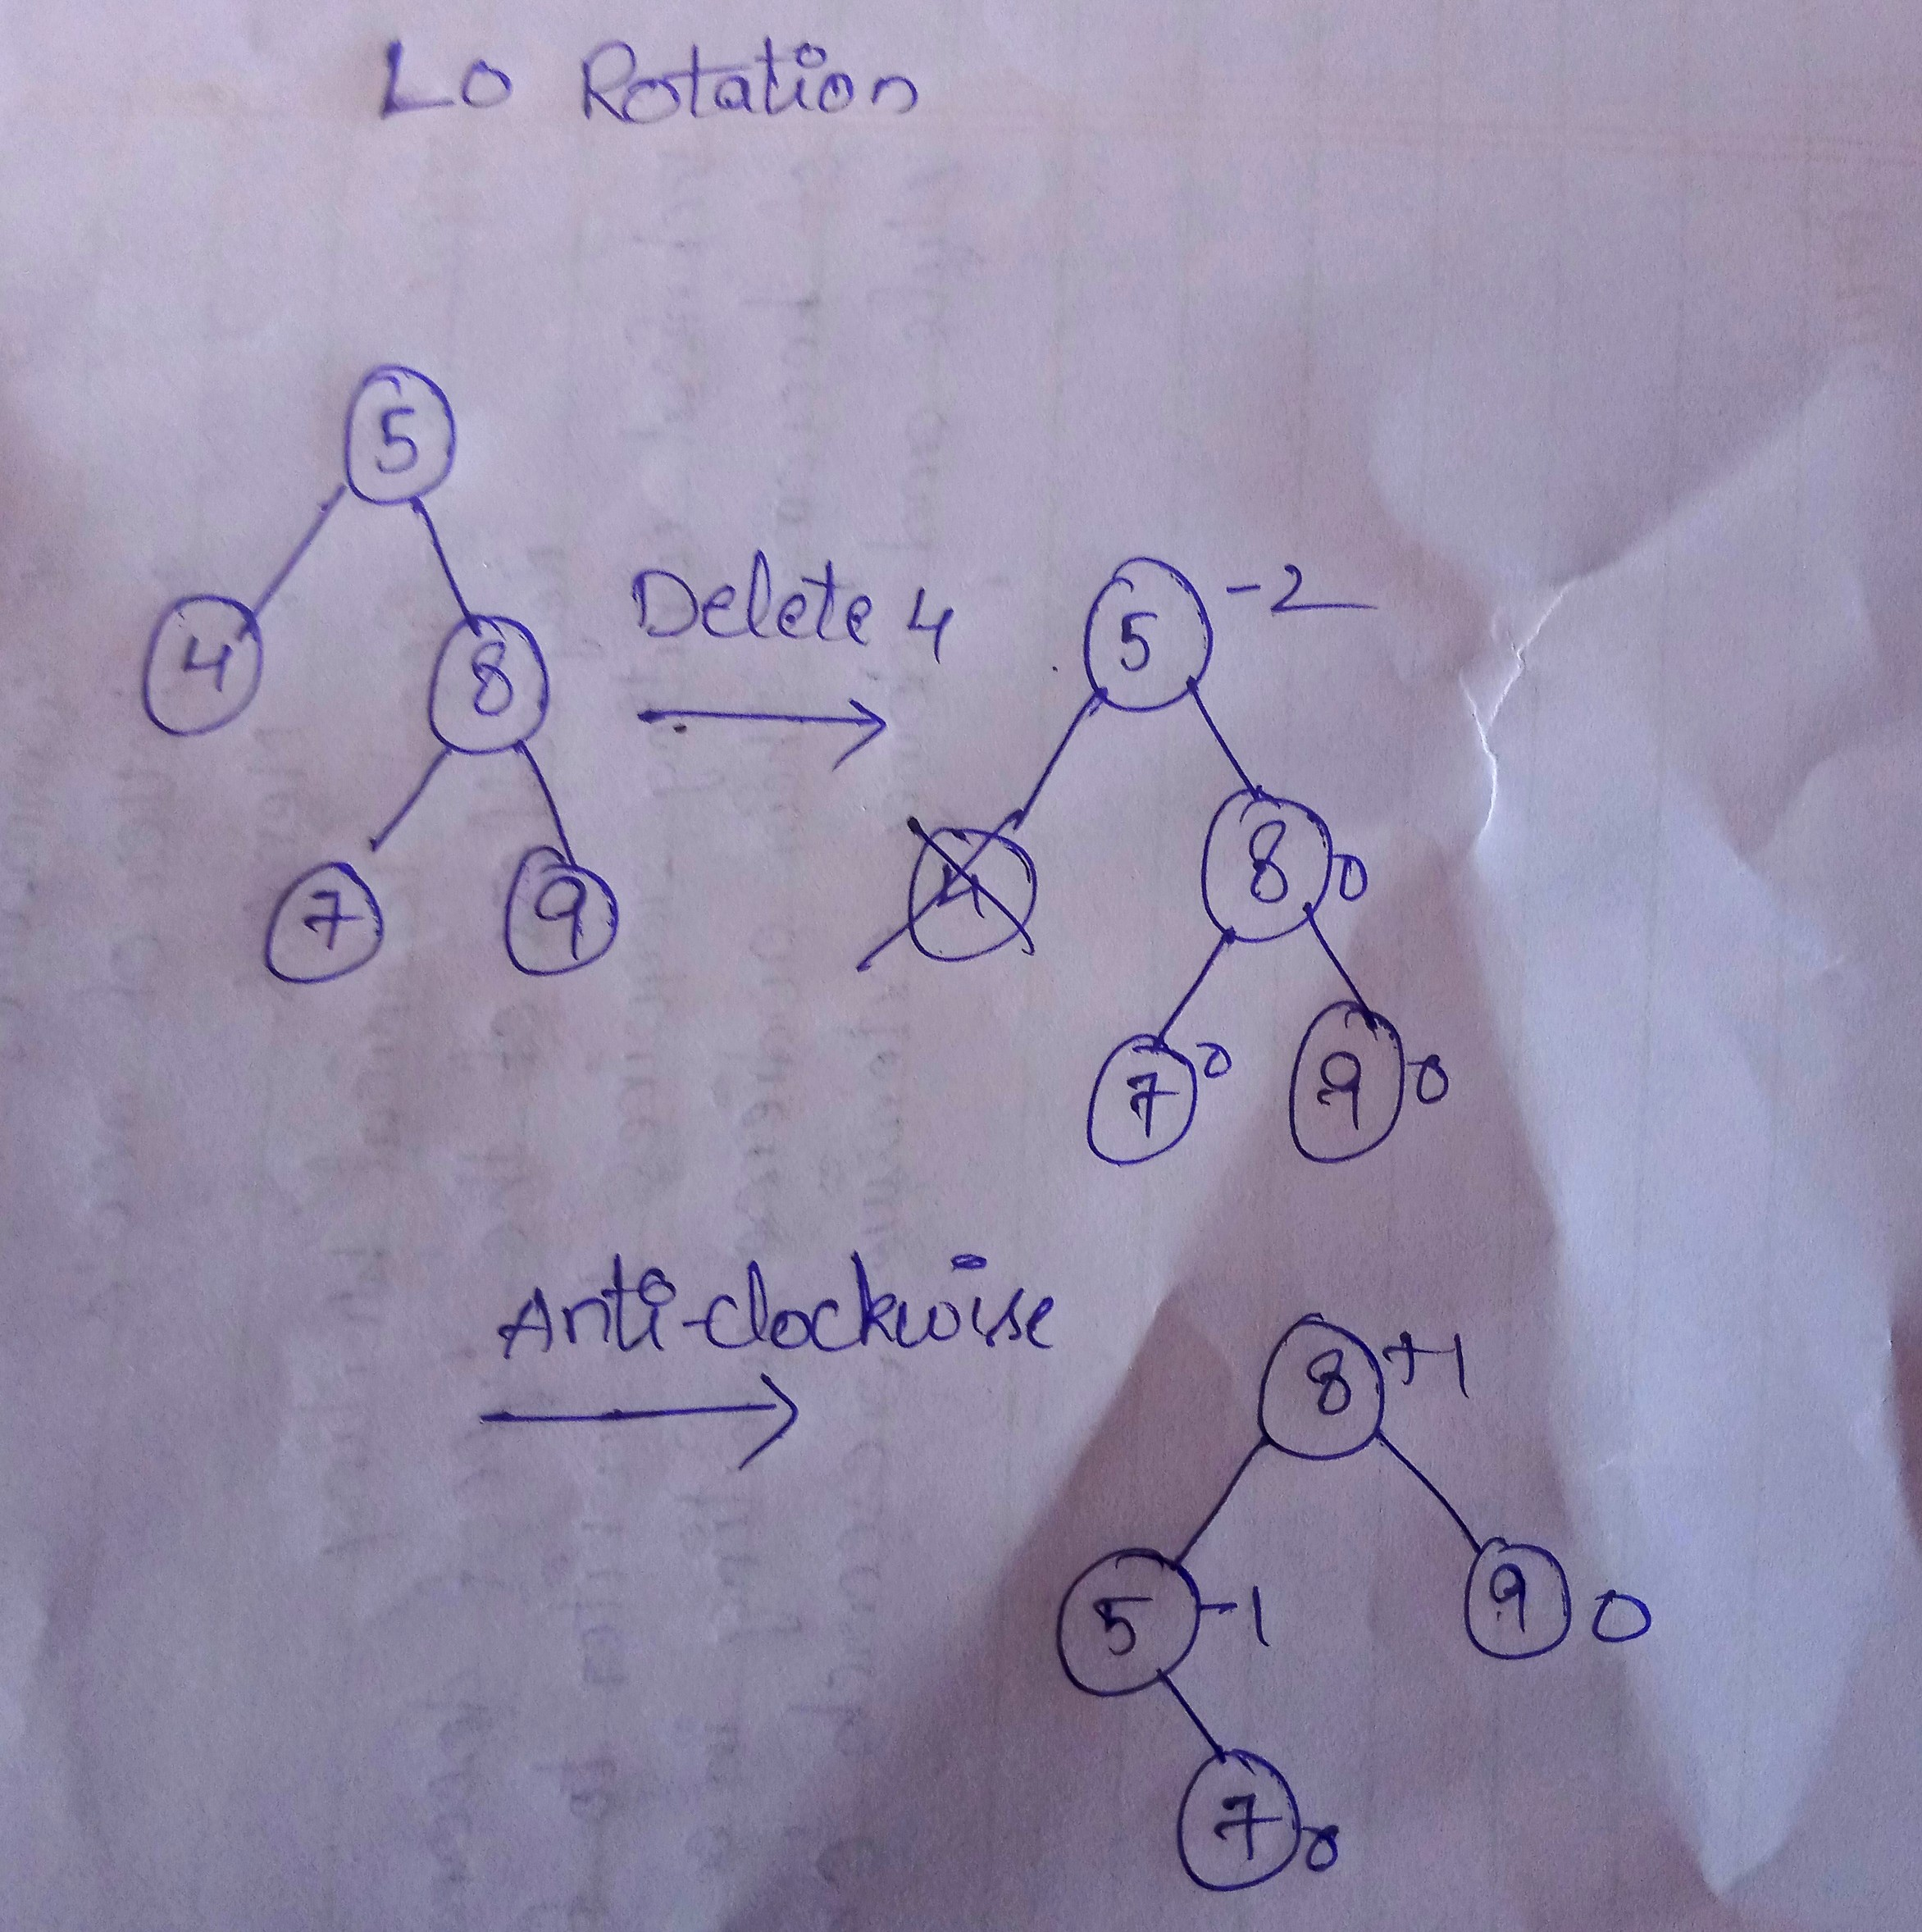
3.L0 ROTATION:-
If the deleted node is at the left side of a tree and the balance factor of the root node is -2 and the right first child balance factor is 0,we call it as L0 notation.
Rotate the right first child of parent in anti-clockwise direction to balance here.

Slide 72
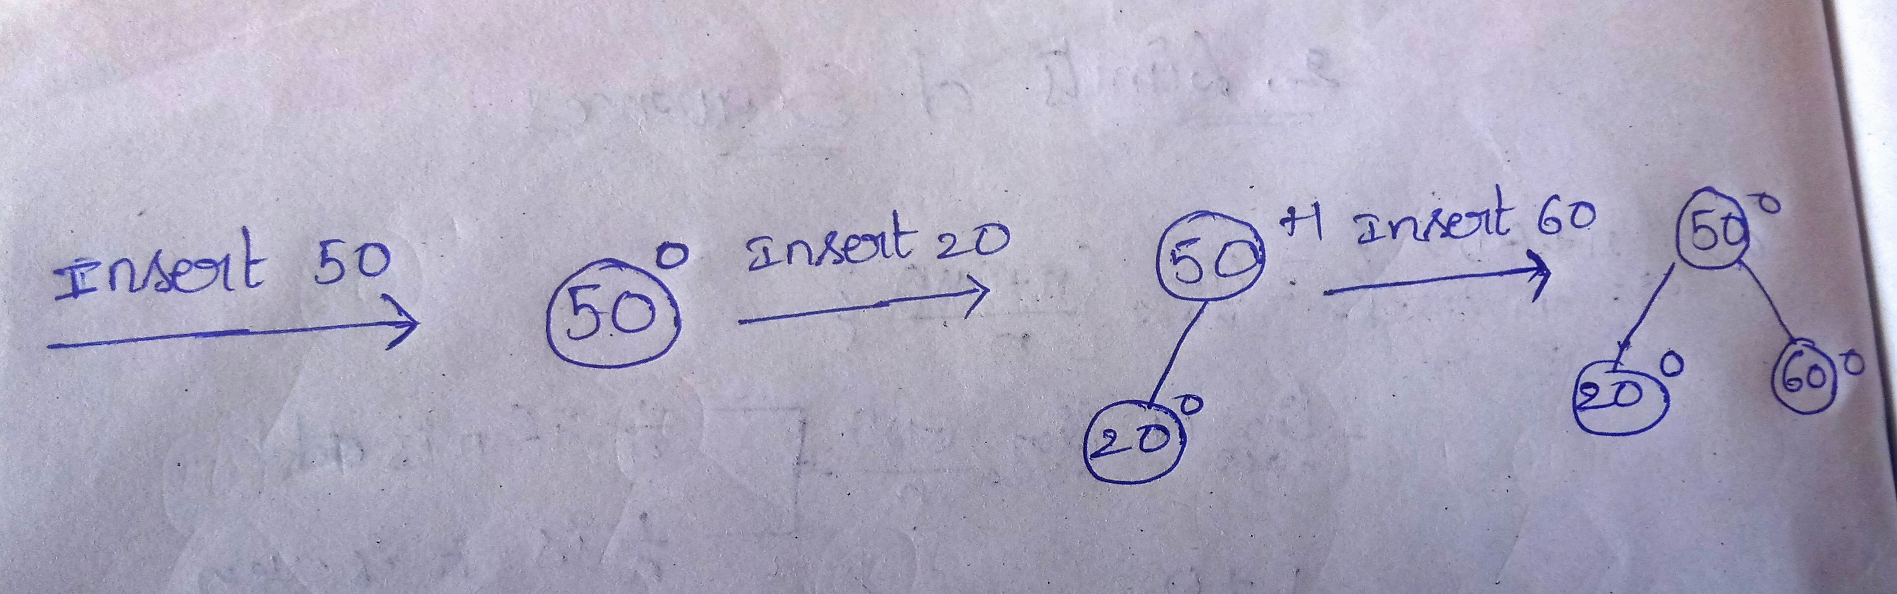
Eg:-INSERT 50,20,60,10,8,15,32,46,11,42 AND THEN DELETE THE NODES 46,15,50.

Slide 73
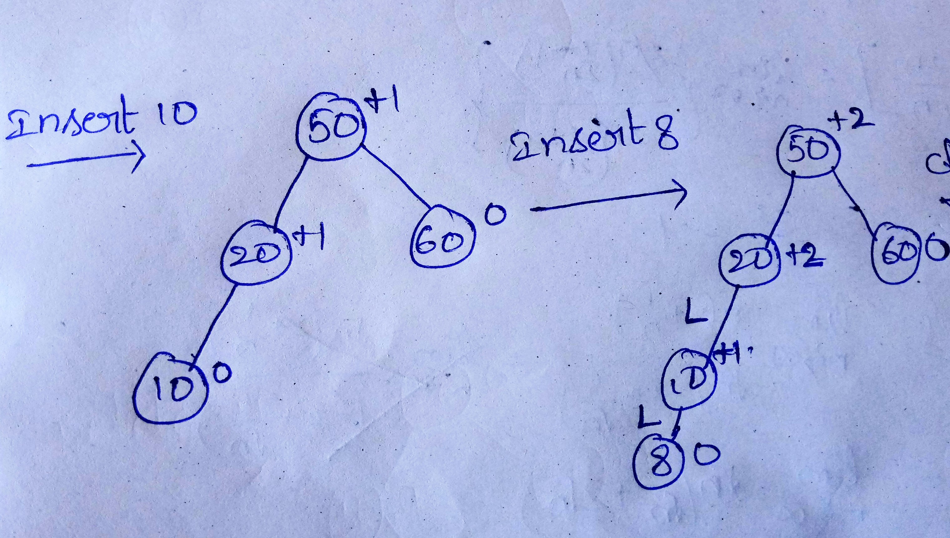
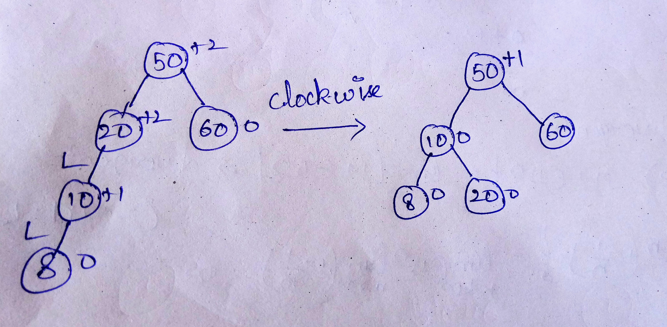

Slide 74
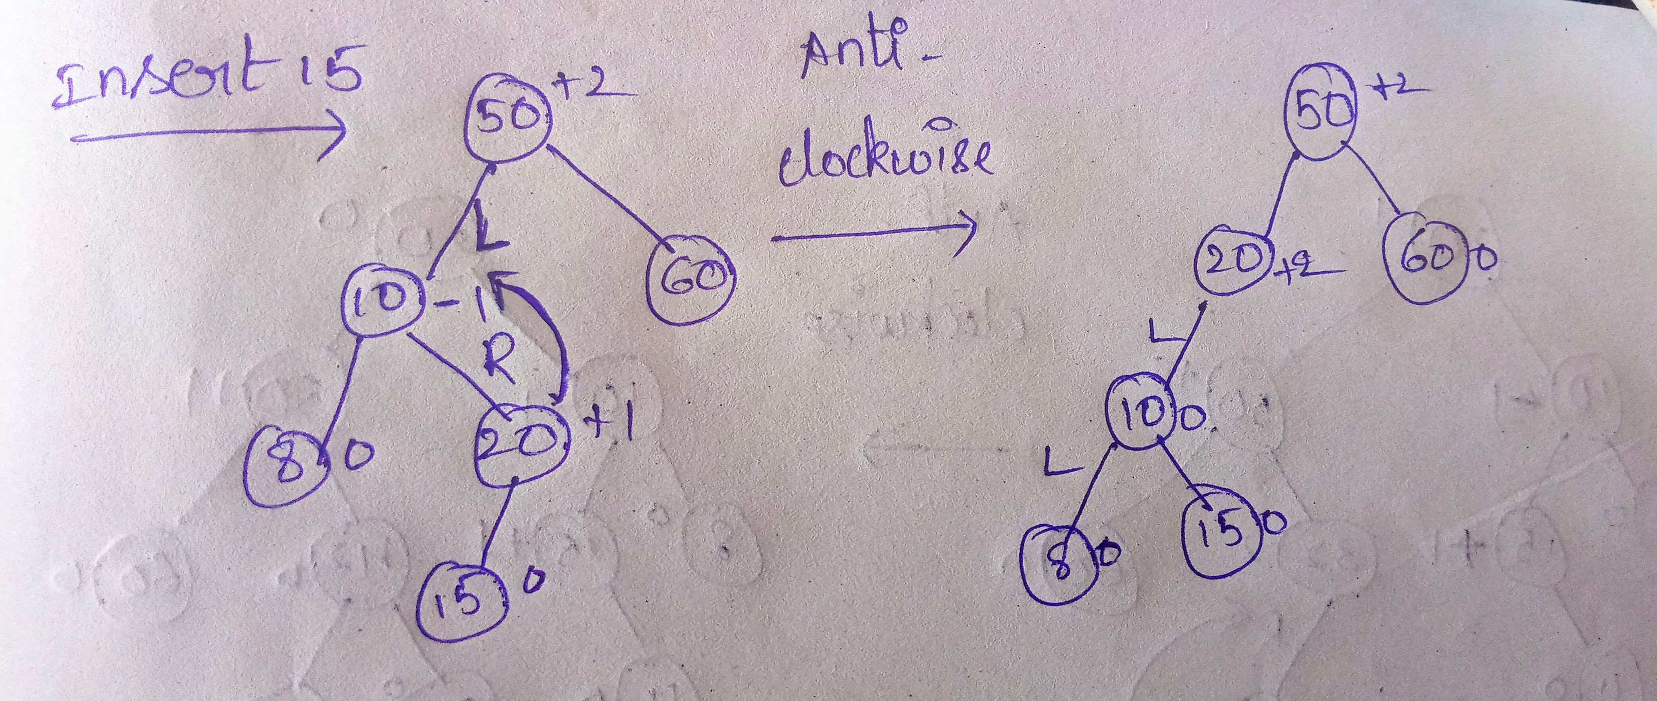
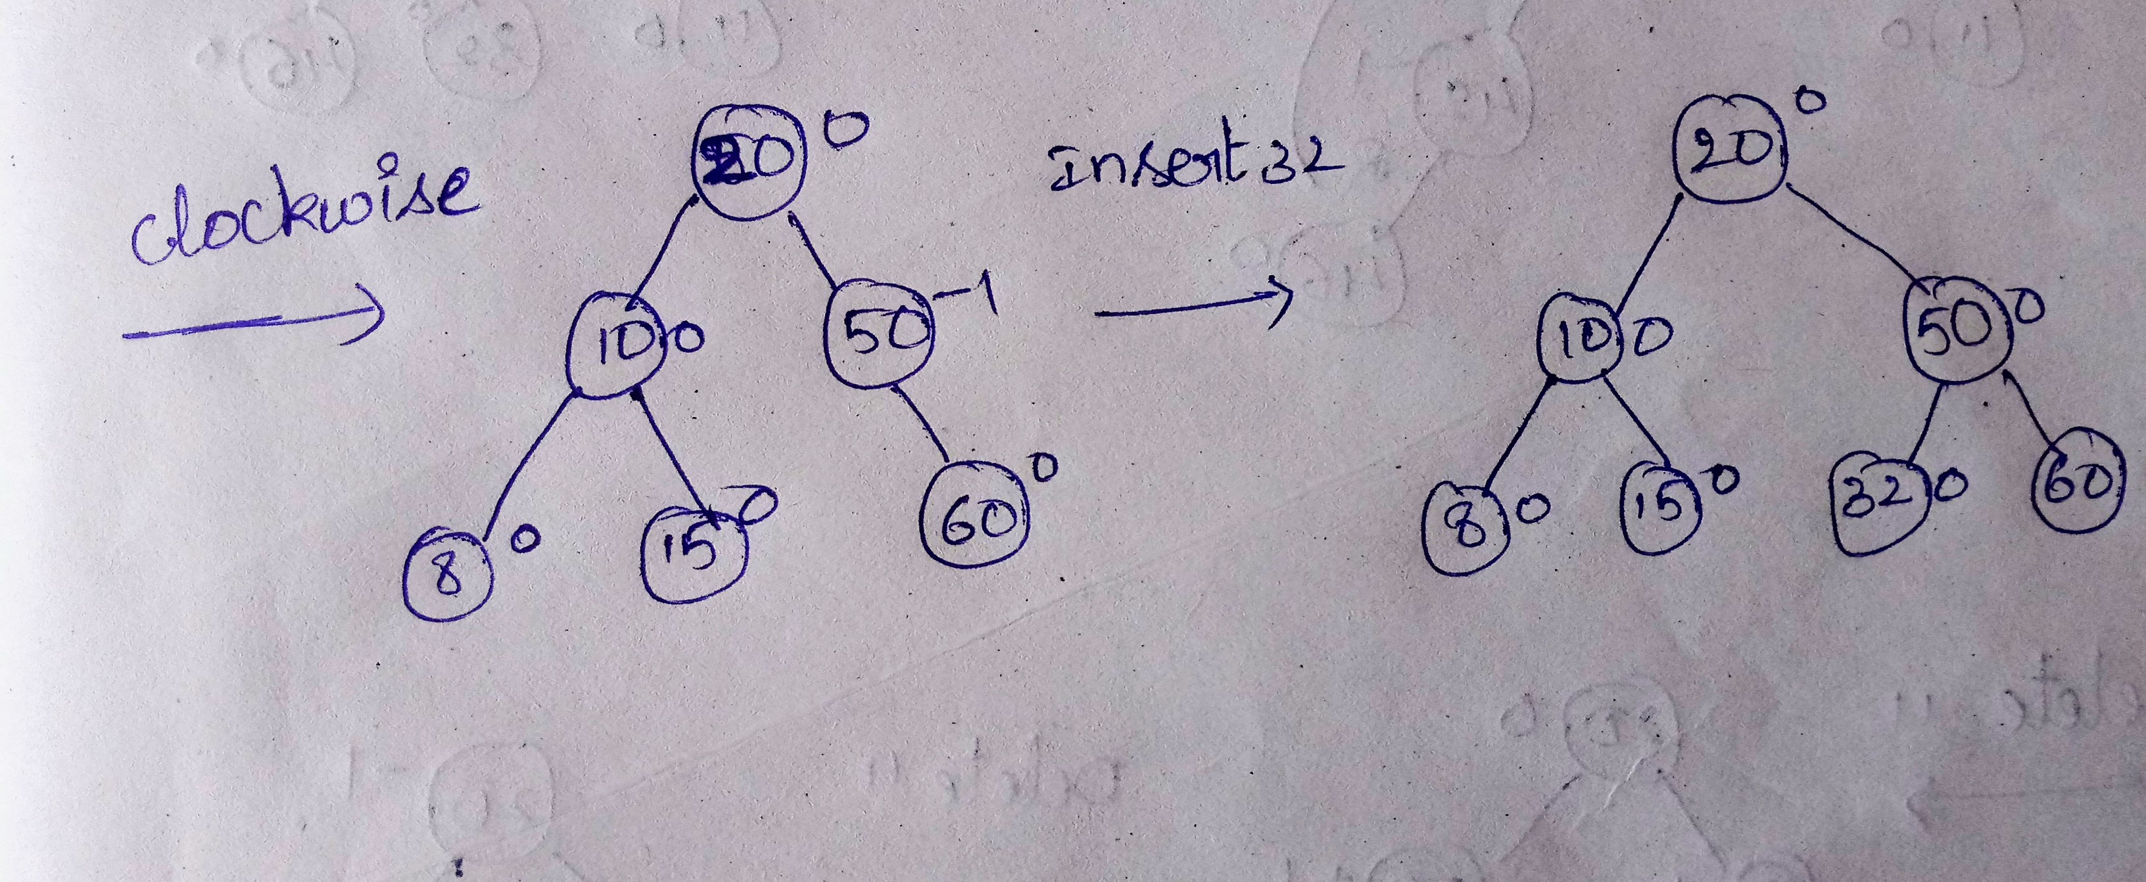

Slide 75
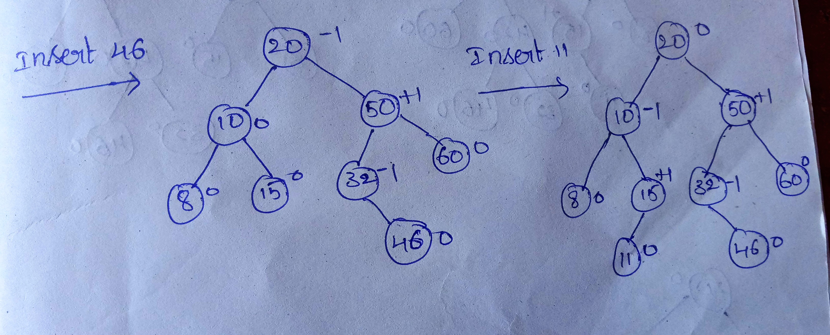
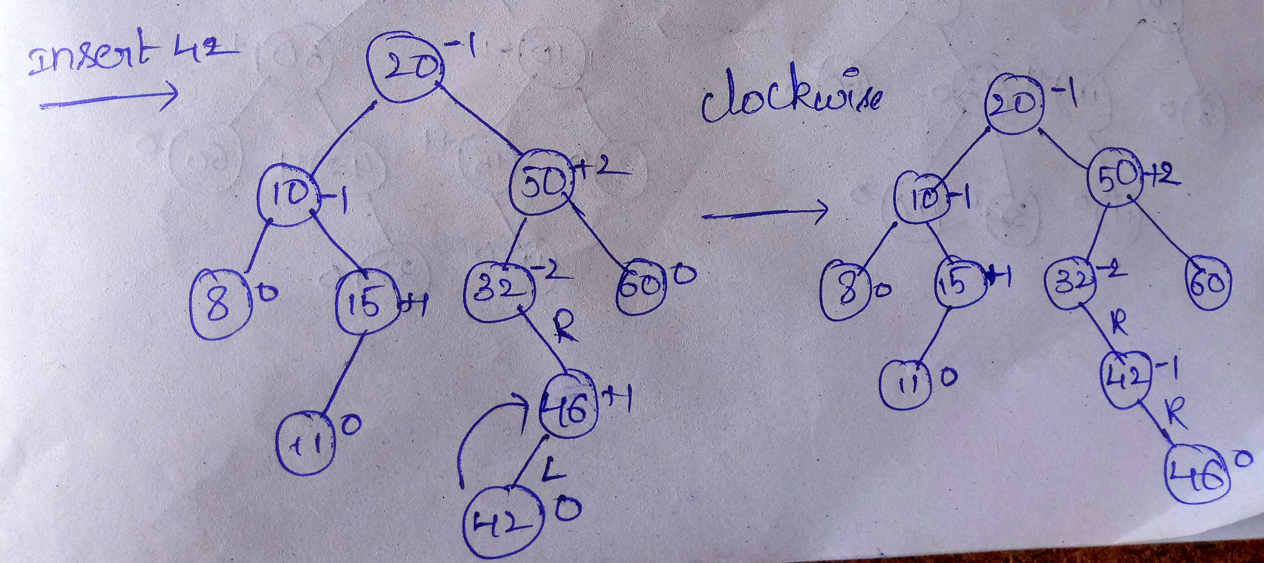

Slide 76
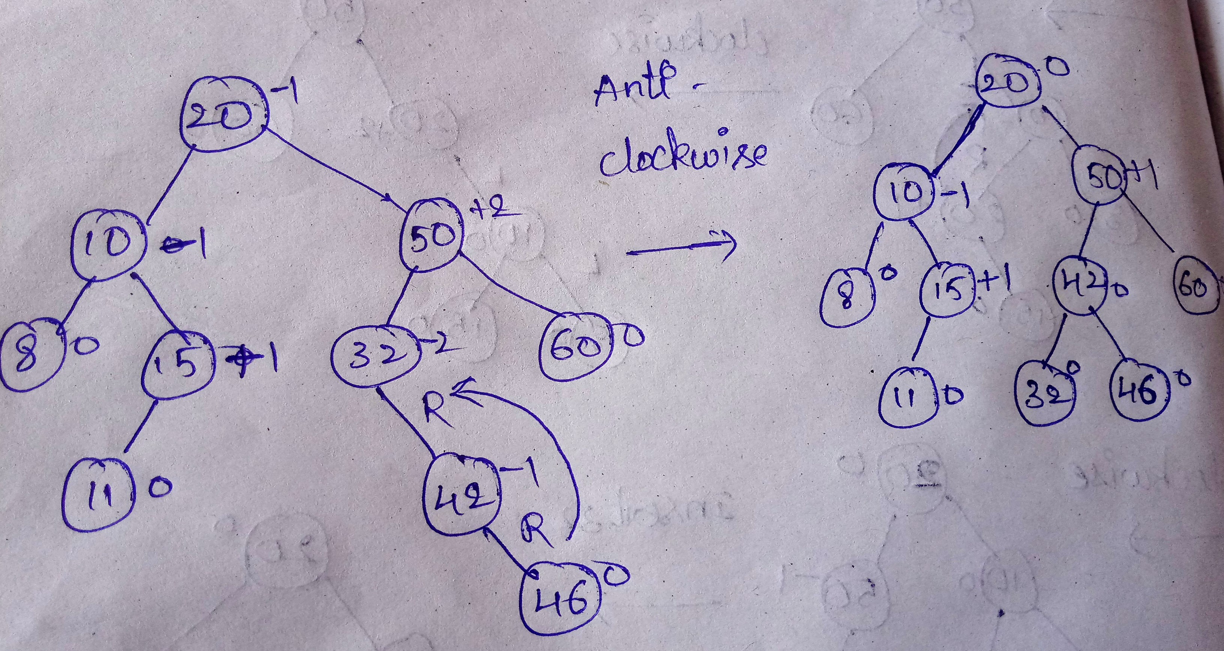
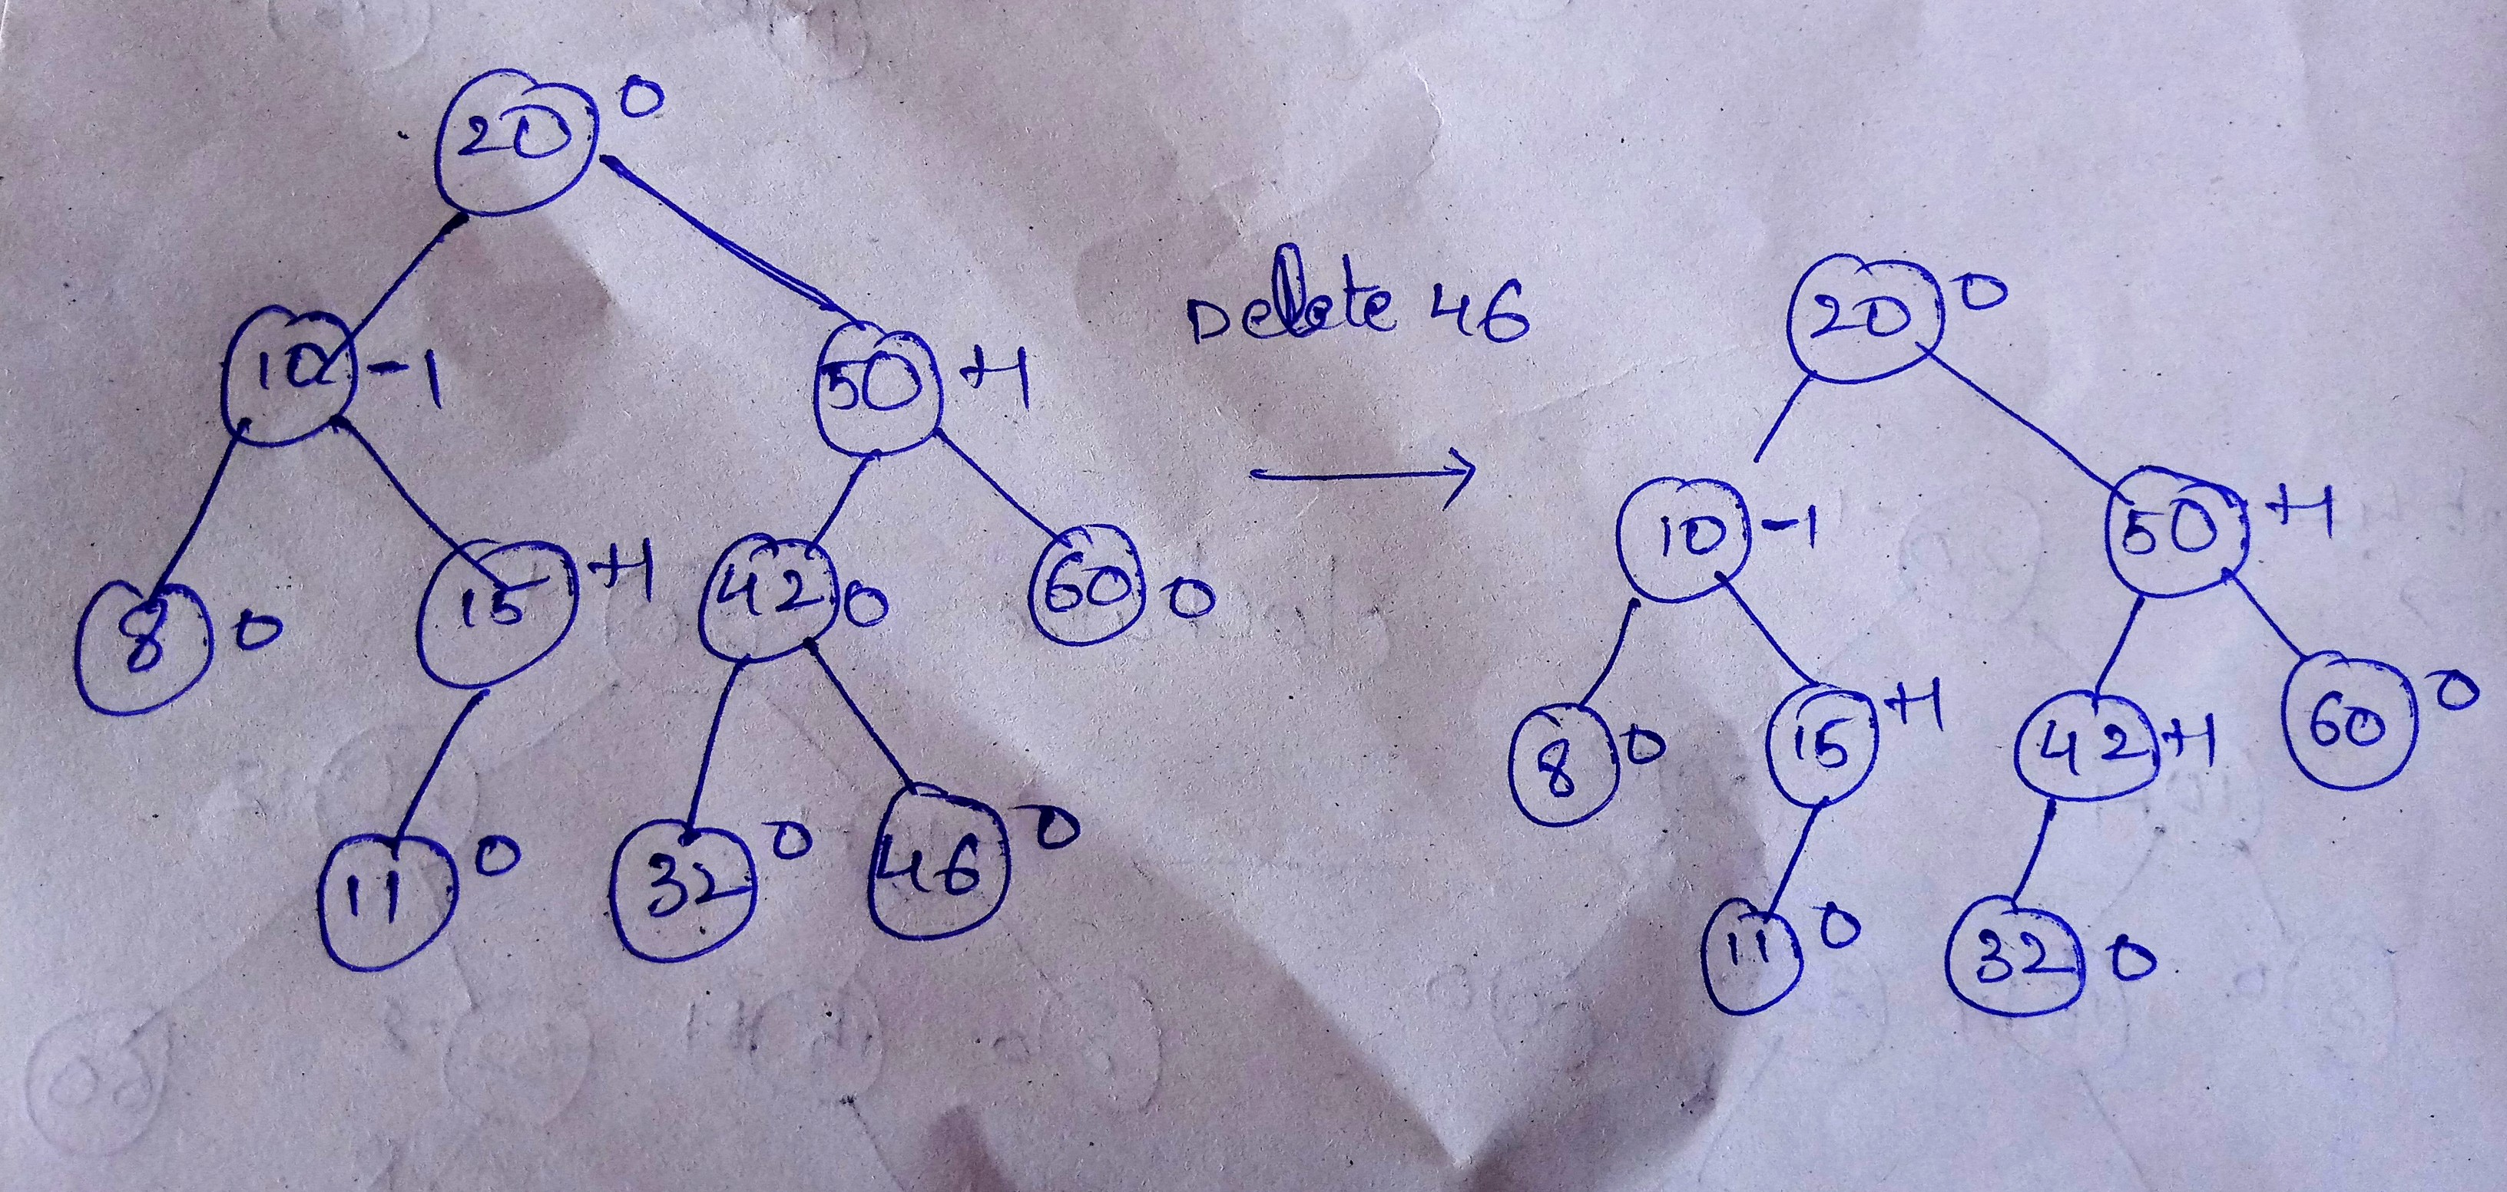

Slide 77
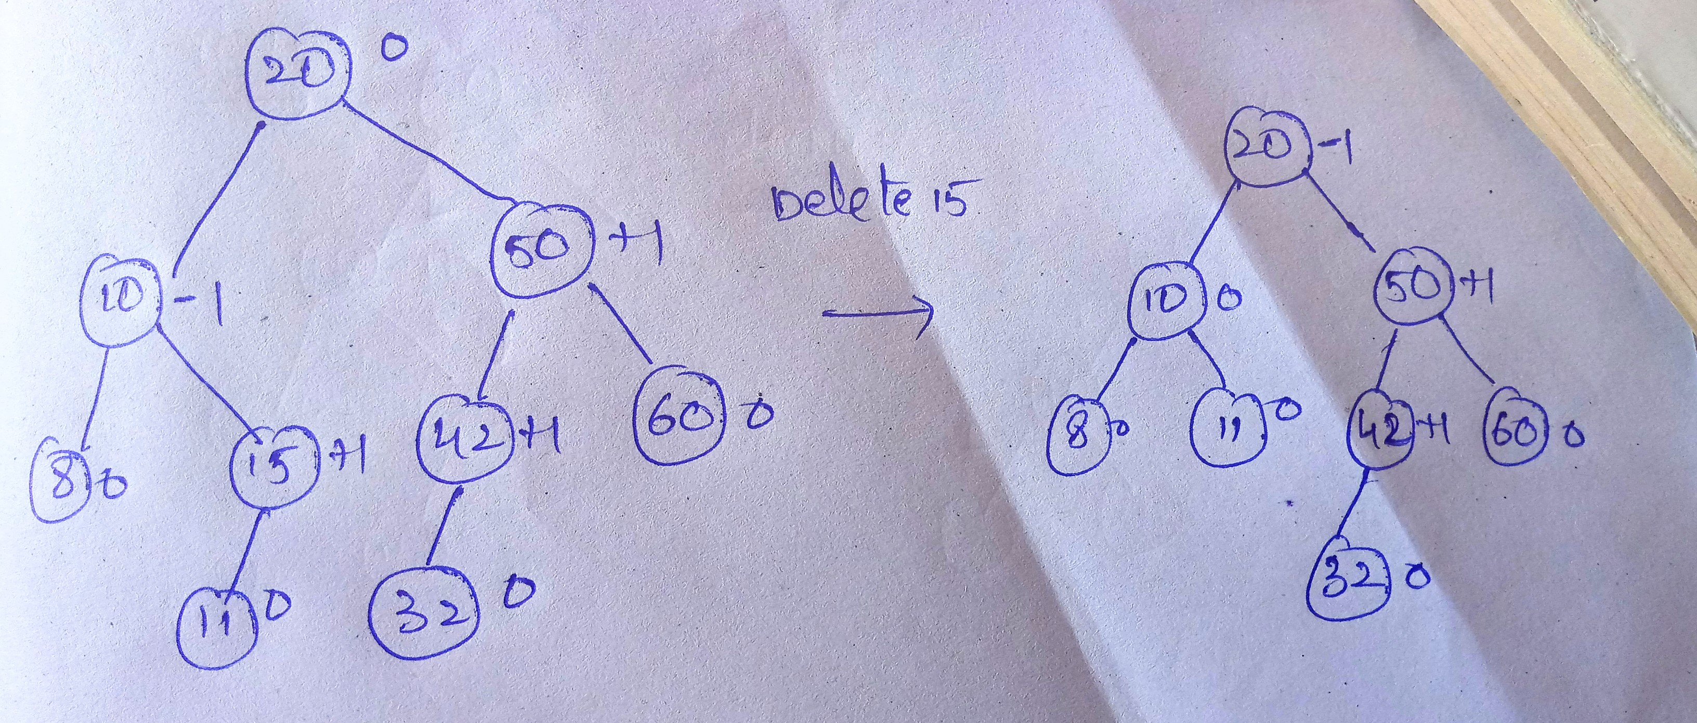
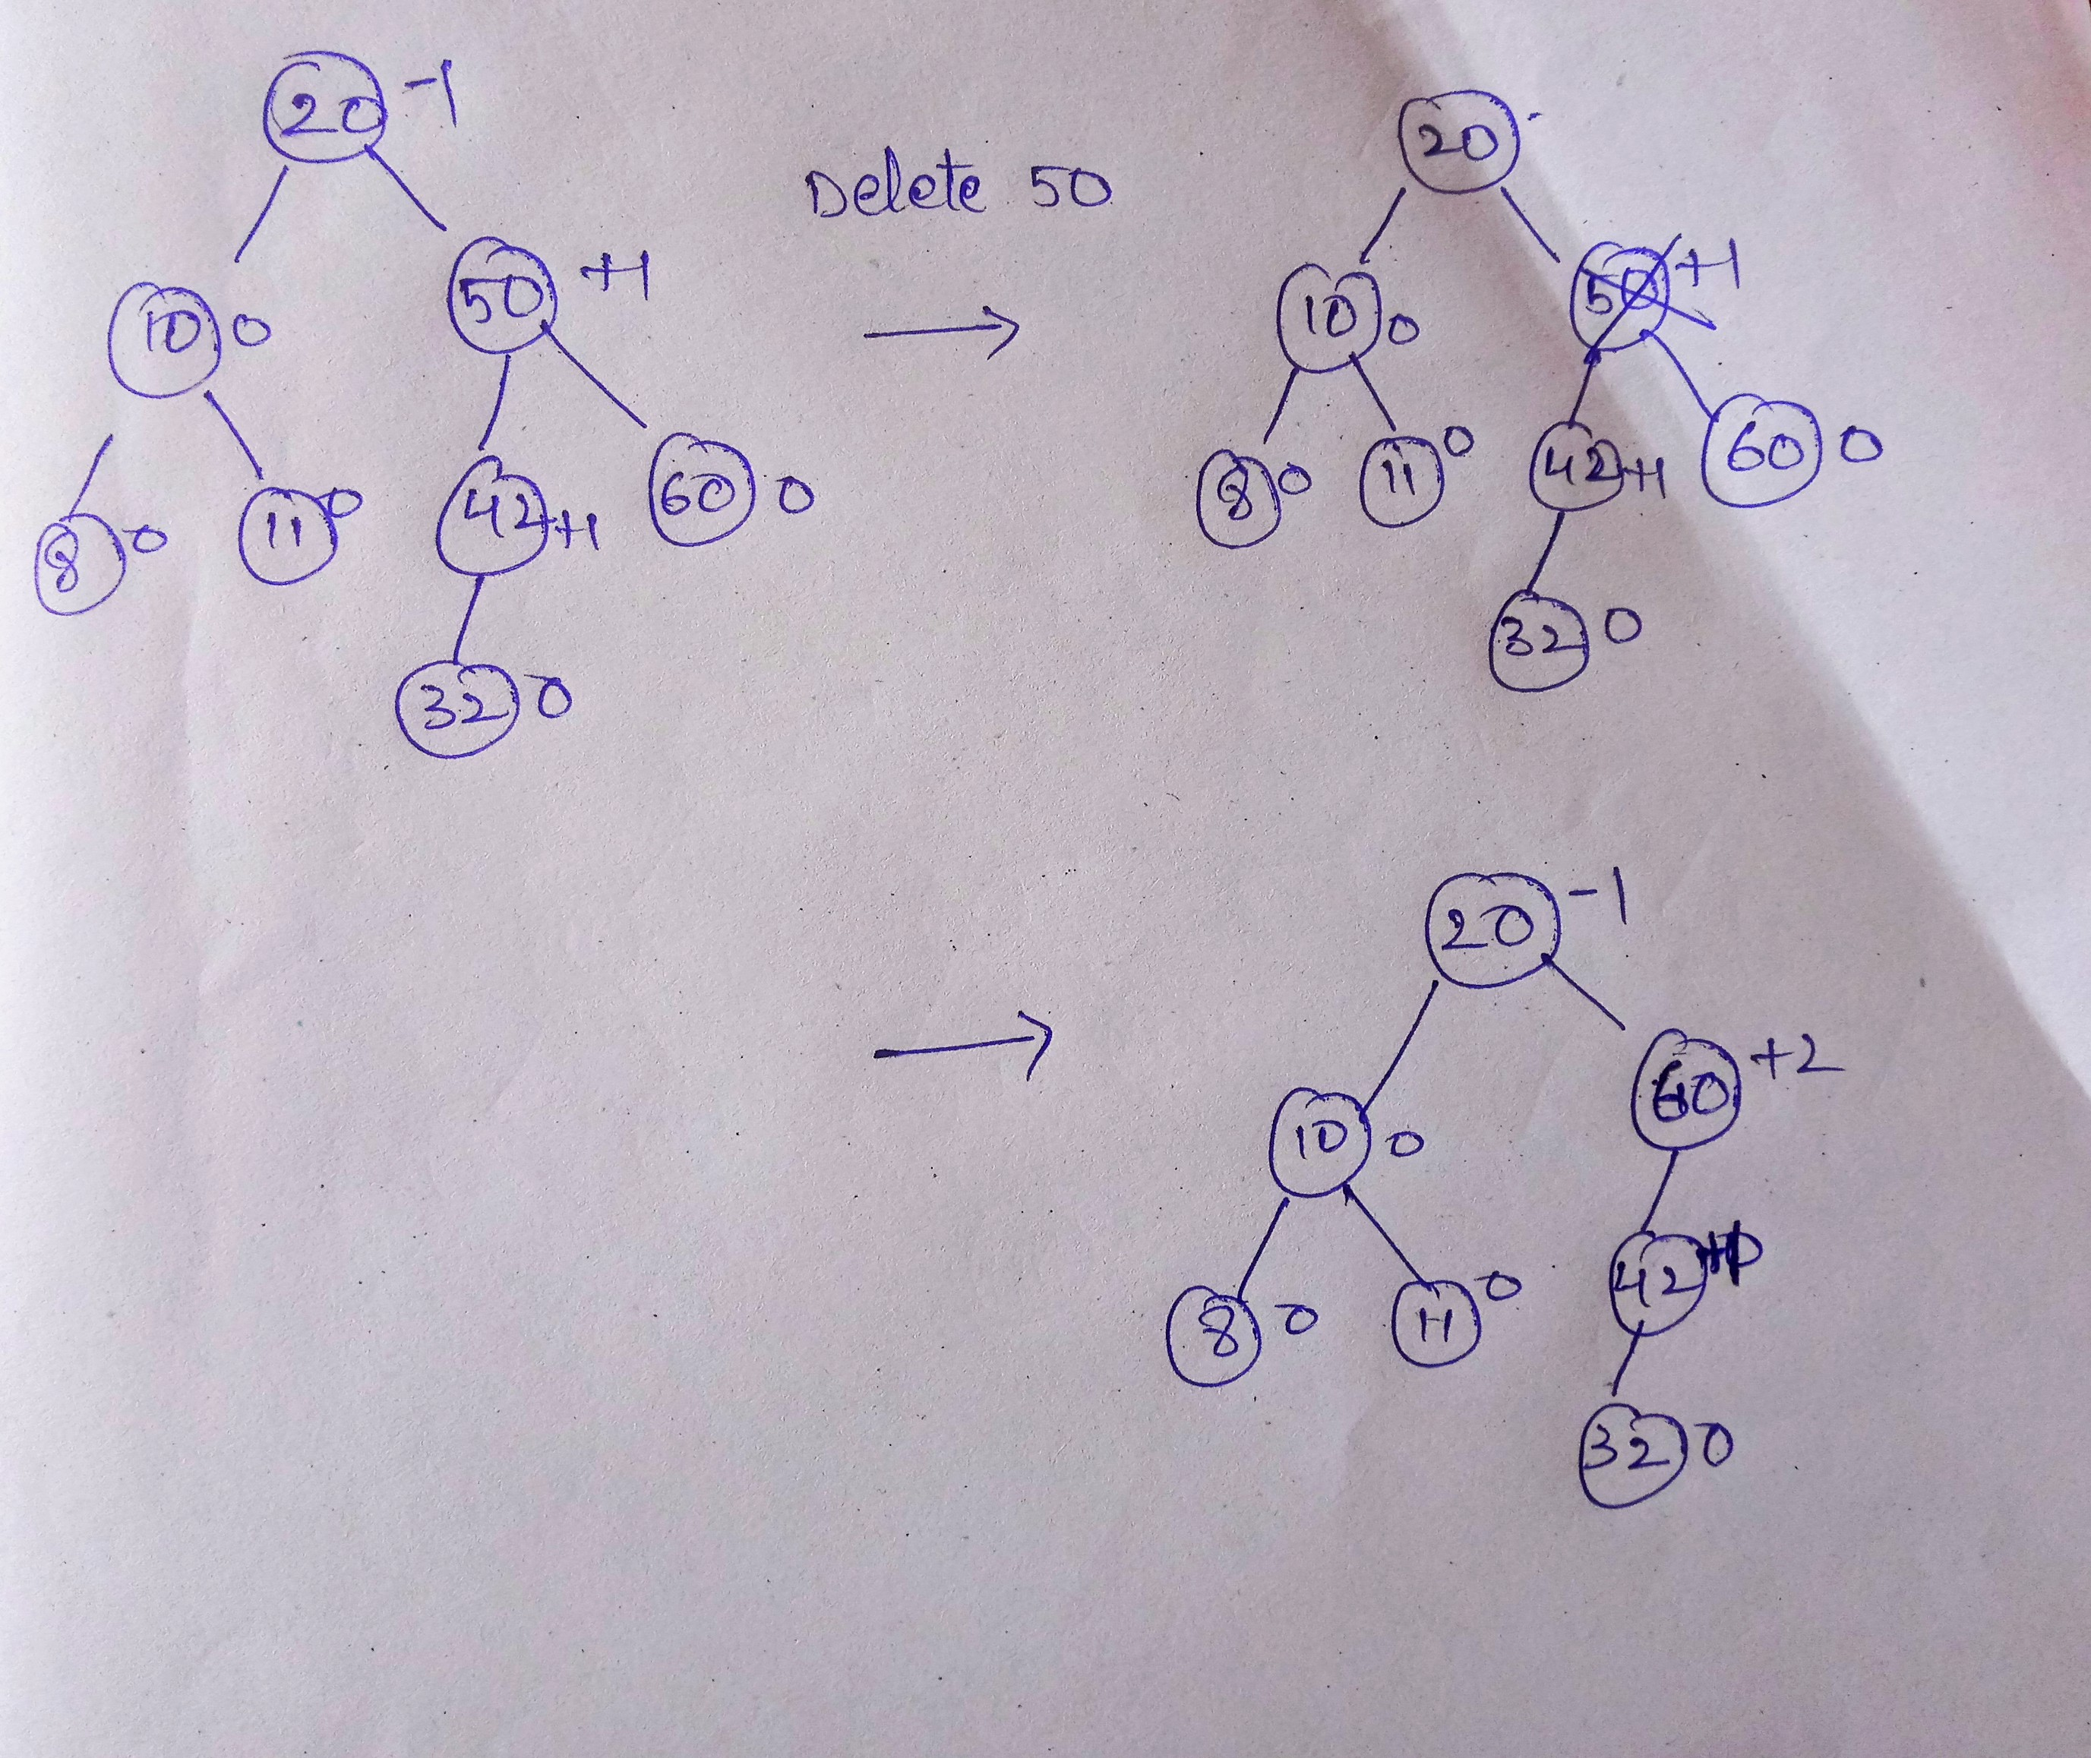

Slide 78
Advantages of AVL trees:
Search is O(log N) since AVL trees are always balanced.
Insertion and deletions are also O(logn), worst case searching is O(1.44 X log n)
The height balancing adds no more than a constant factor to the speed of insertion.
Drawback of AVL trees:
Difficult to program & debug; more space for balance factor.
Asymptotically faster but rebalancing costs time.
Most large searches are done in database systems on disk and use other structures (e.g. B-trees).
May be OK to have O(N) for a single operation if total run time for many consecutive operations is fast (e.g. Splay trees).

Slide 79
Queries???
(jayakrishna@rguktsklm.ac.in)

